Slide 1
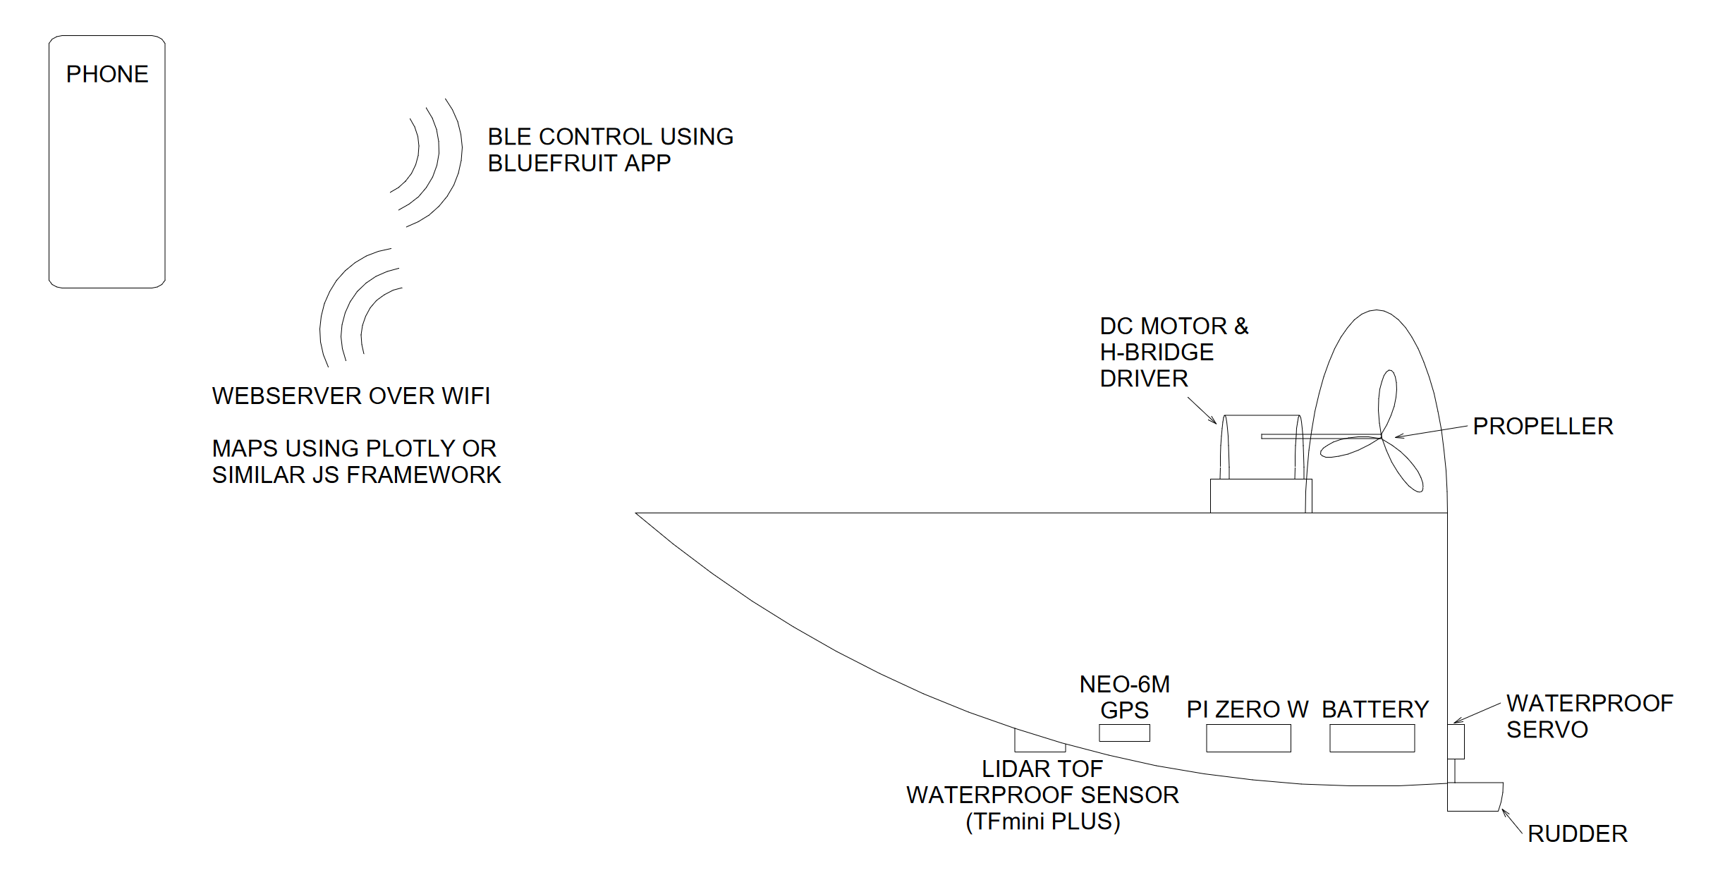
Airboat 4180
Bluetooth controlled airboat with GPS and LiDAR to topographically map lake floors.
BLUETOOTH
Designed by Zachary Mathews

Slide 2
Parts
Aluminum Paint Tray
Waterproof Glue
CanaKit Raspberry Pi Zero W Kit
(2) 5V/2A Portable Chargers
USB Type A to Mini B USB Mini-B Breakout (5V/2A)
H-Bridge Dual TB6612FNG Motor Driver
Brushless DC Motor
Waterproof Servo
Waterproof TFmini Plus Li-DAR
NEO-6M GPS Module
USB to TTL Adapter

Slide 3
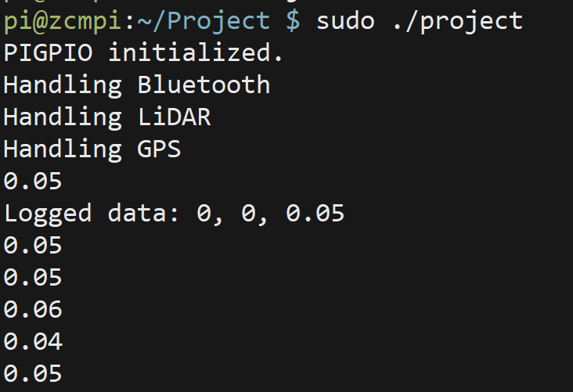

Software
PIGPIO was the IO library of choice -> software PWM
Developed serial class to handle Bluetooth and GPS signals
Developed motor class to handle motor control
Developed servo class to handle motor positioning
Developed simple IO class to provide operator overloading for PWM and digital pins
Multithreaded
Parse NMEA data -> x,y coordinates
Parse LiDAR data -> z coordinate
Bluetooth control
Requires RFCOMM protocol to simulate RS-232

Slide 4
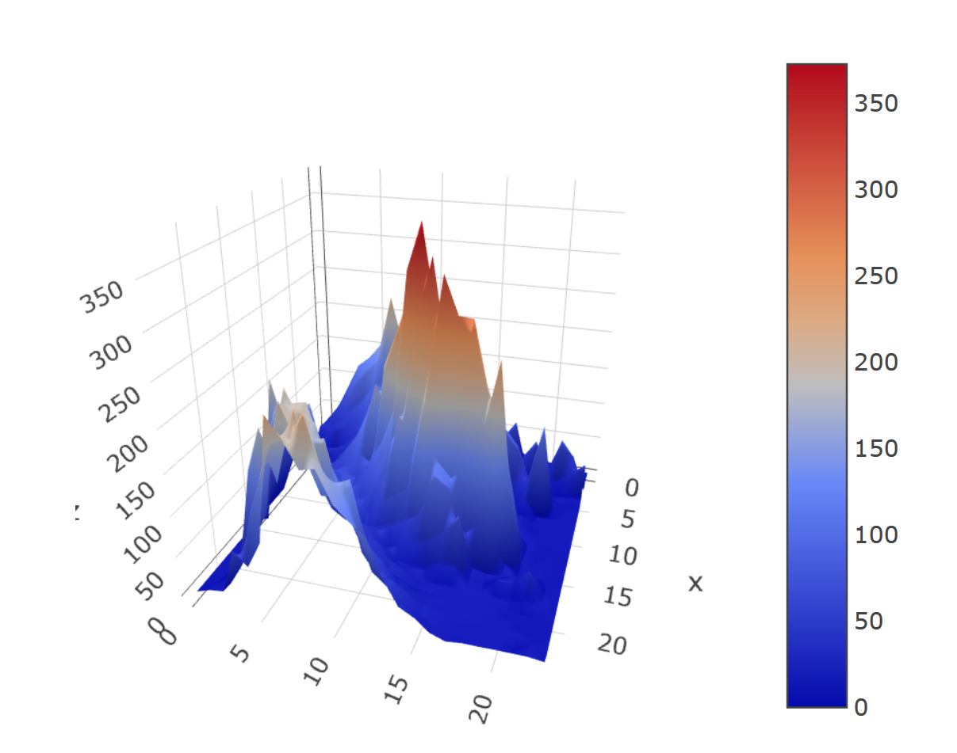
Web Interface
Apache Webserver
Plain HTML/Javascript
Uses Plotly Javascript graphing library to draw 3D surface plot
Yet to test it on water
https://plot.ly/javascript/3d-surface-plots/

Slide 5
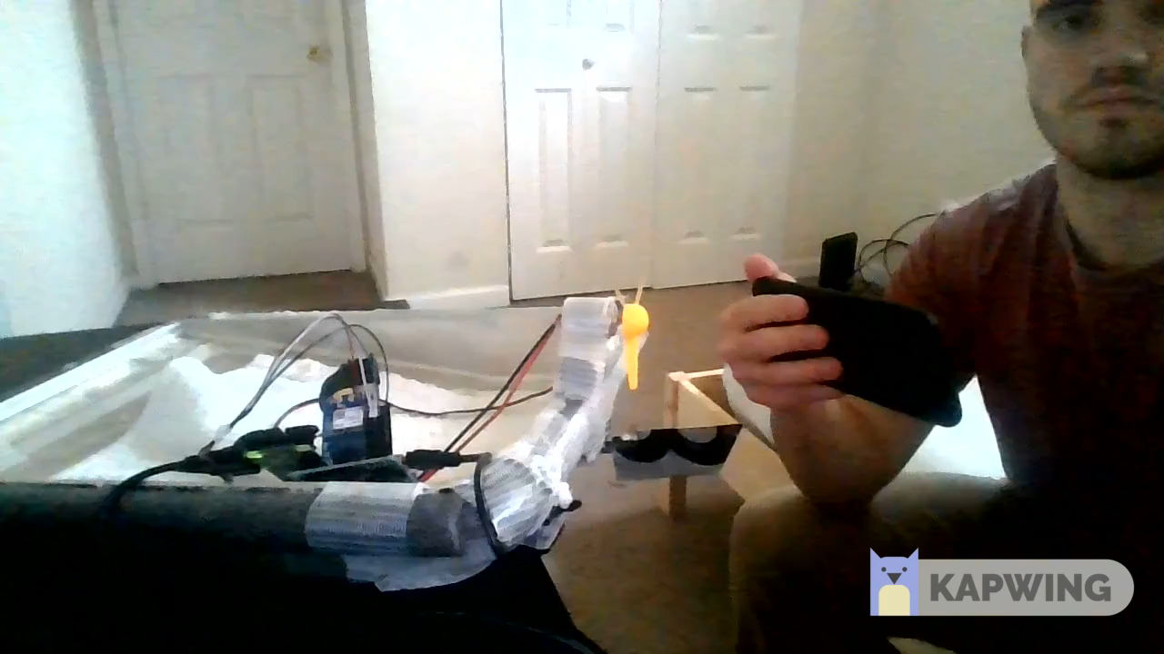

Slide 6
Future Work
Handle motor inrush current
Kills LiDAR and GPS communications
To be implemented in software
Averaging gyro measurements to eliminate jitter
Better app for Bluetooth control
Design custom PCB in the same layout as protoboard
Flesh out the website
Allow for more than one data log to be mapped
Run code at boot

